Slide 1
ExecutiveSummary_AbedTabbalat
File created on: 2/5/2023 11:55:27 AM

Slide 2
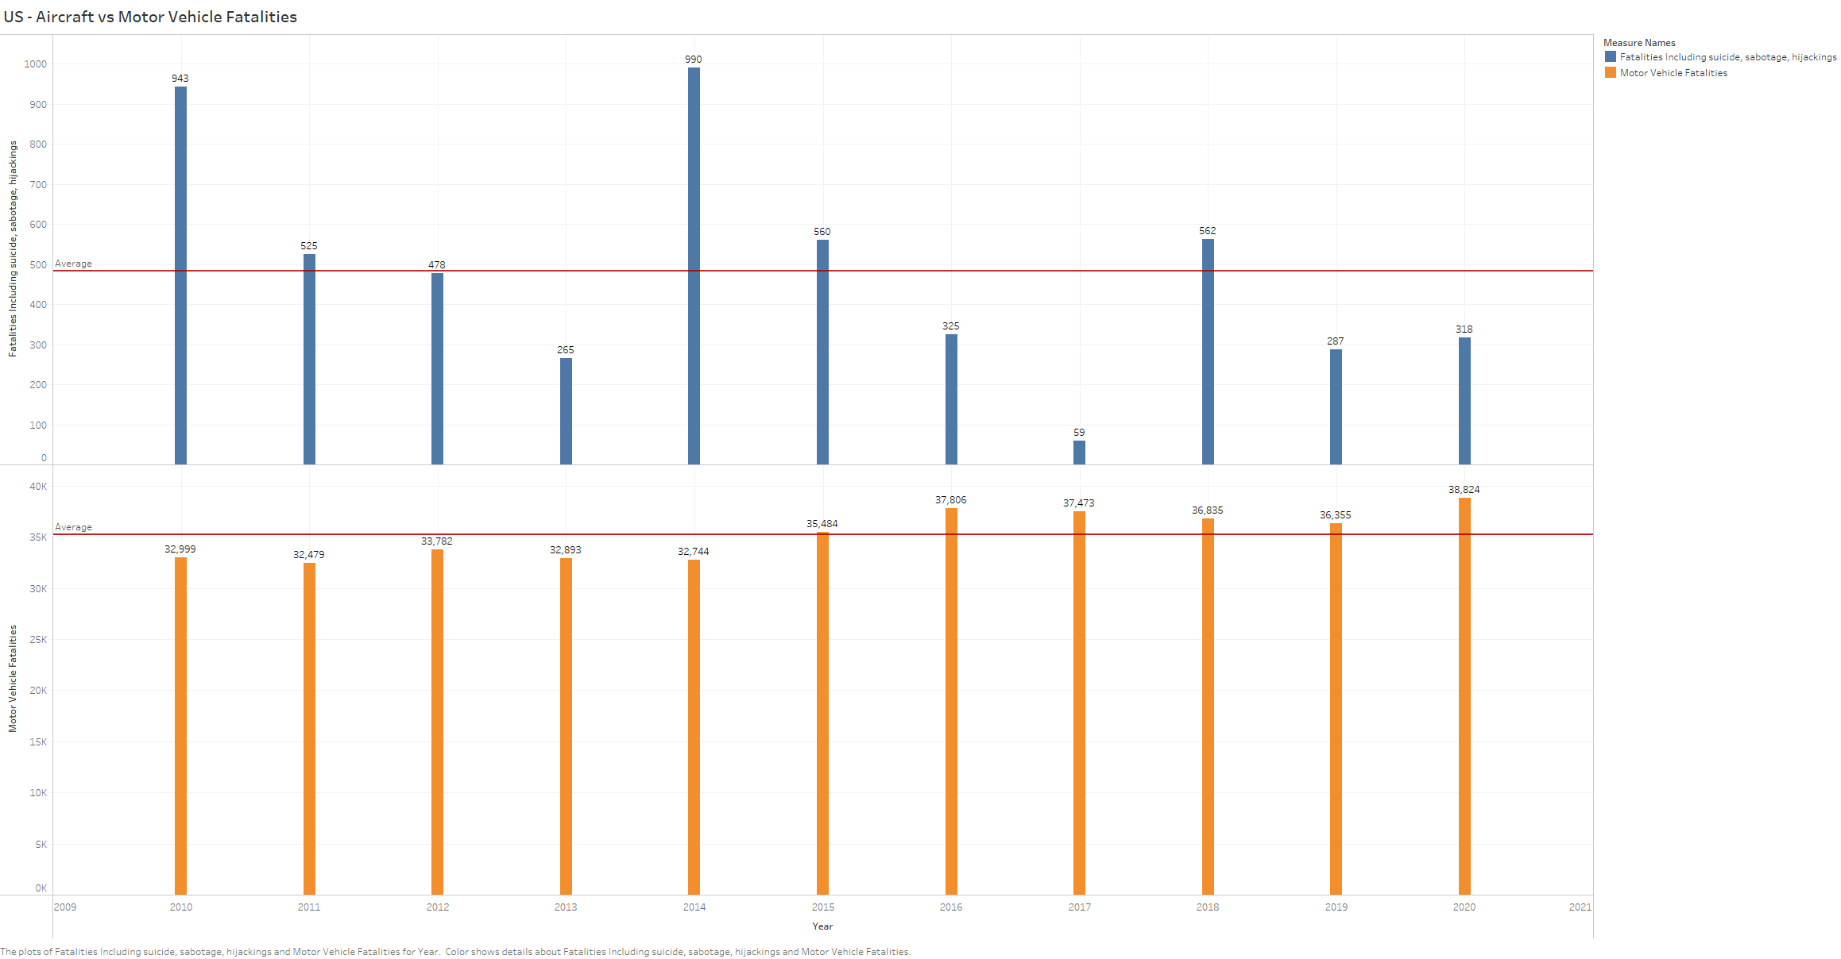

Slide 3
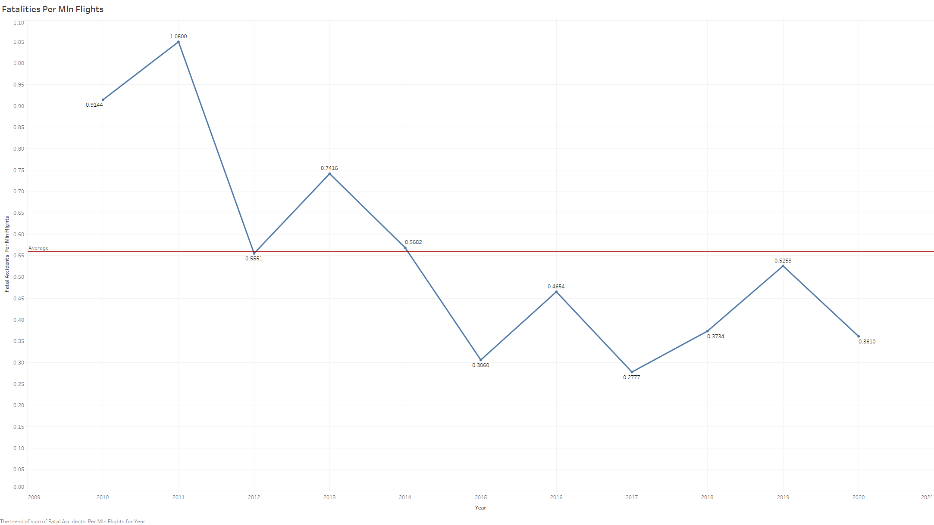

Slide 4
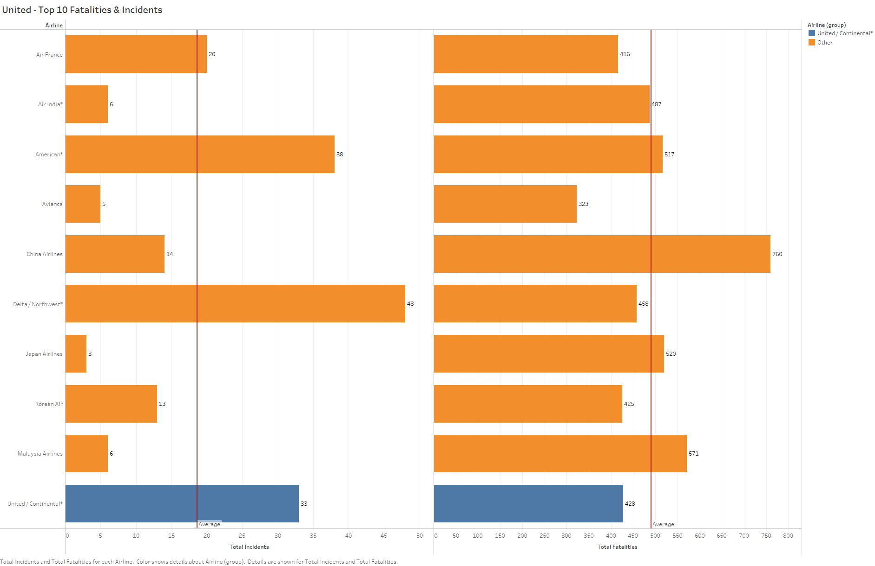

Slide 5
